Slide 1

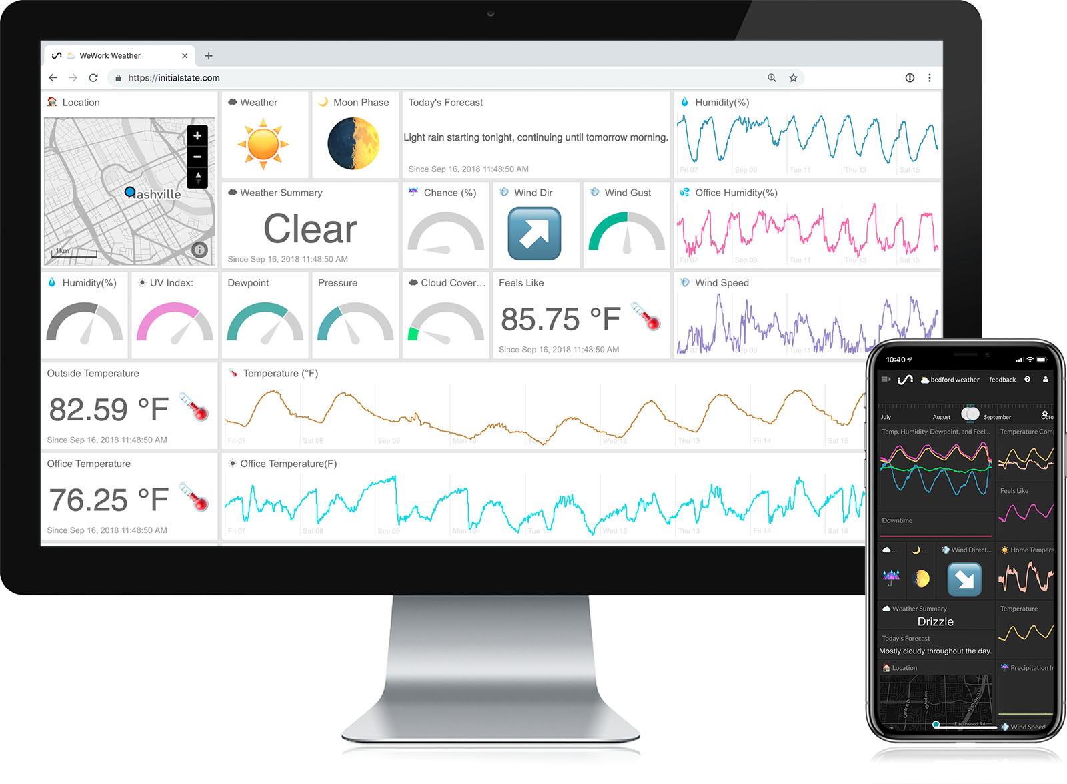
Powered by Power BI
Sales & Product Performance Dashboard
NAME : SANKET SHINDE

Slide 2

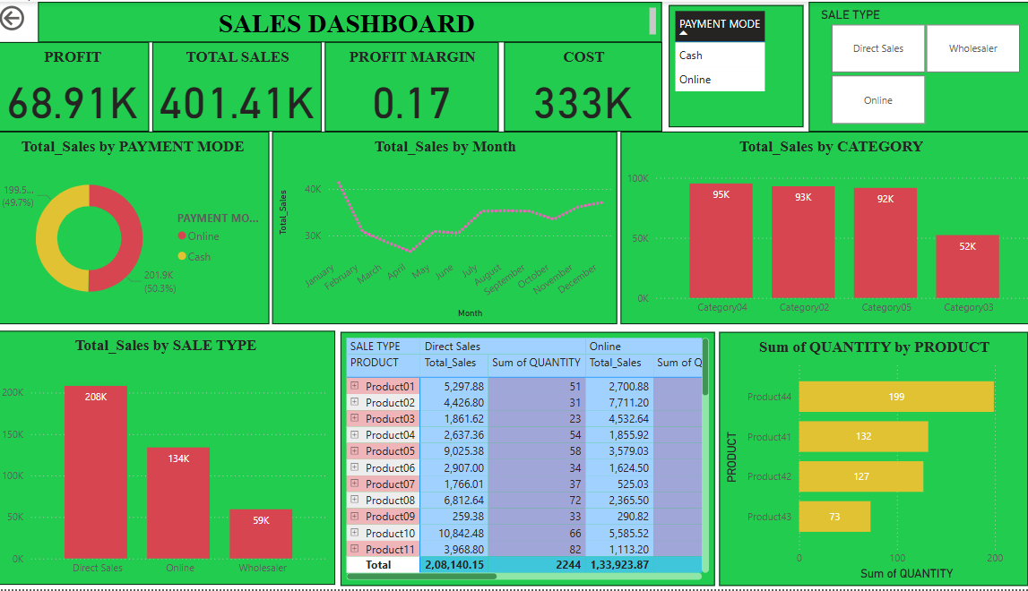
DASHBOARD

Slide 3

This dashboard provides a comprehensive overview of product sales, profit, and trends across different categories, sale types, and payment modes
key insights:
Total Revenue: 401.41 K
Profit : 0.17%
Highest category sale: 95 K

Slide 4

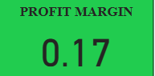
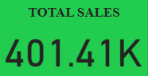
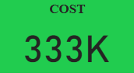
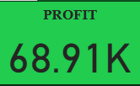
KPIs

Slide 5
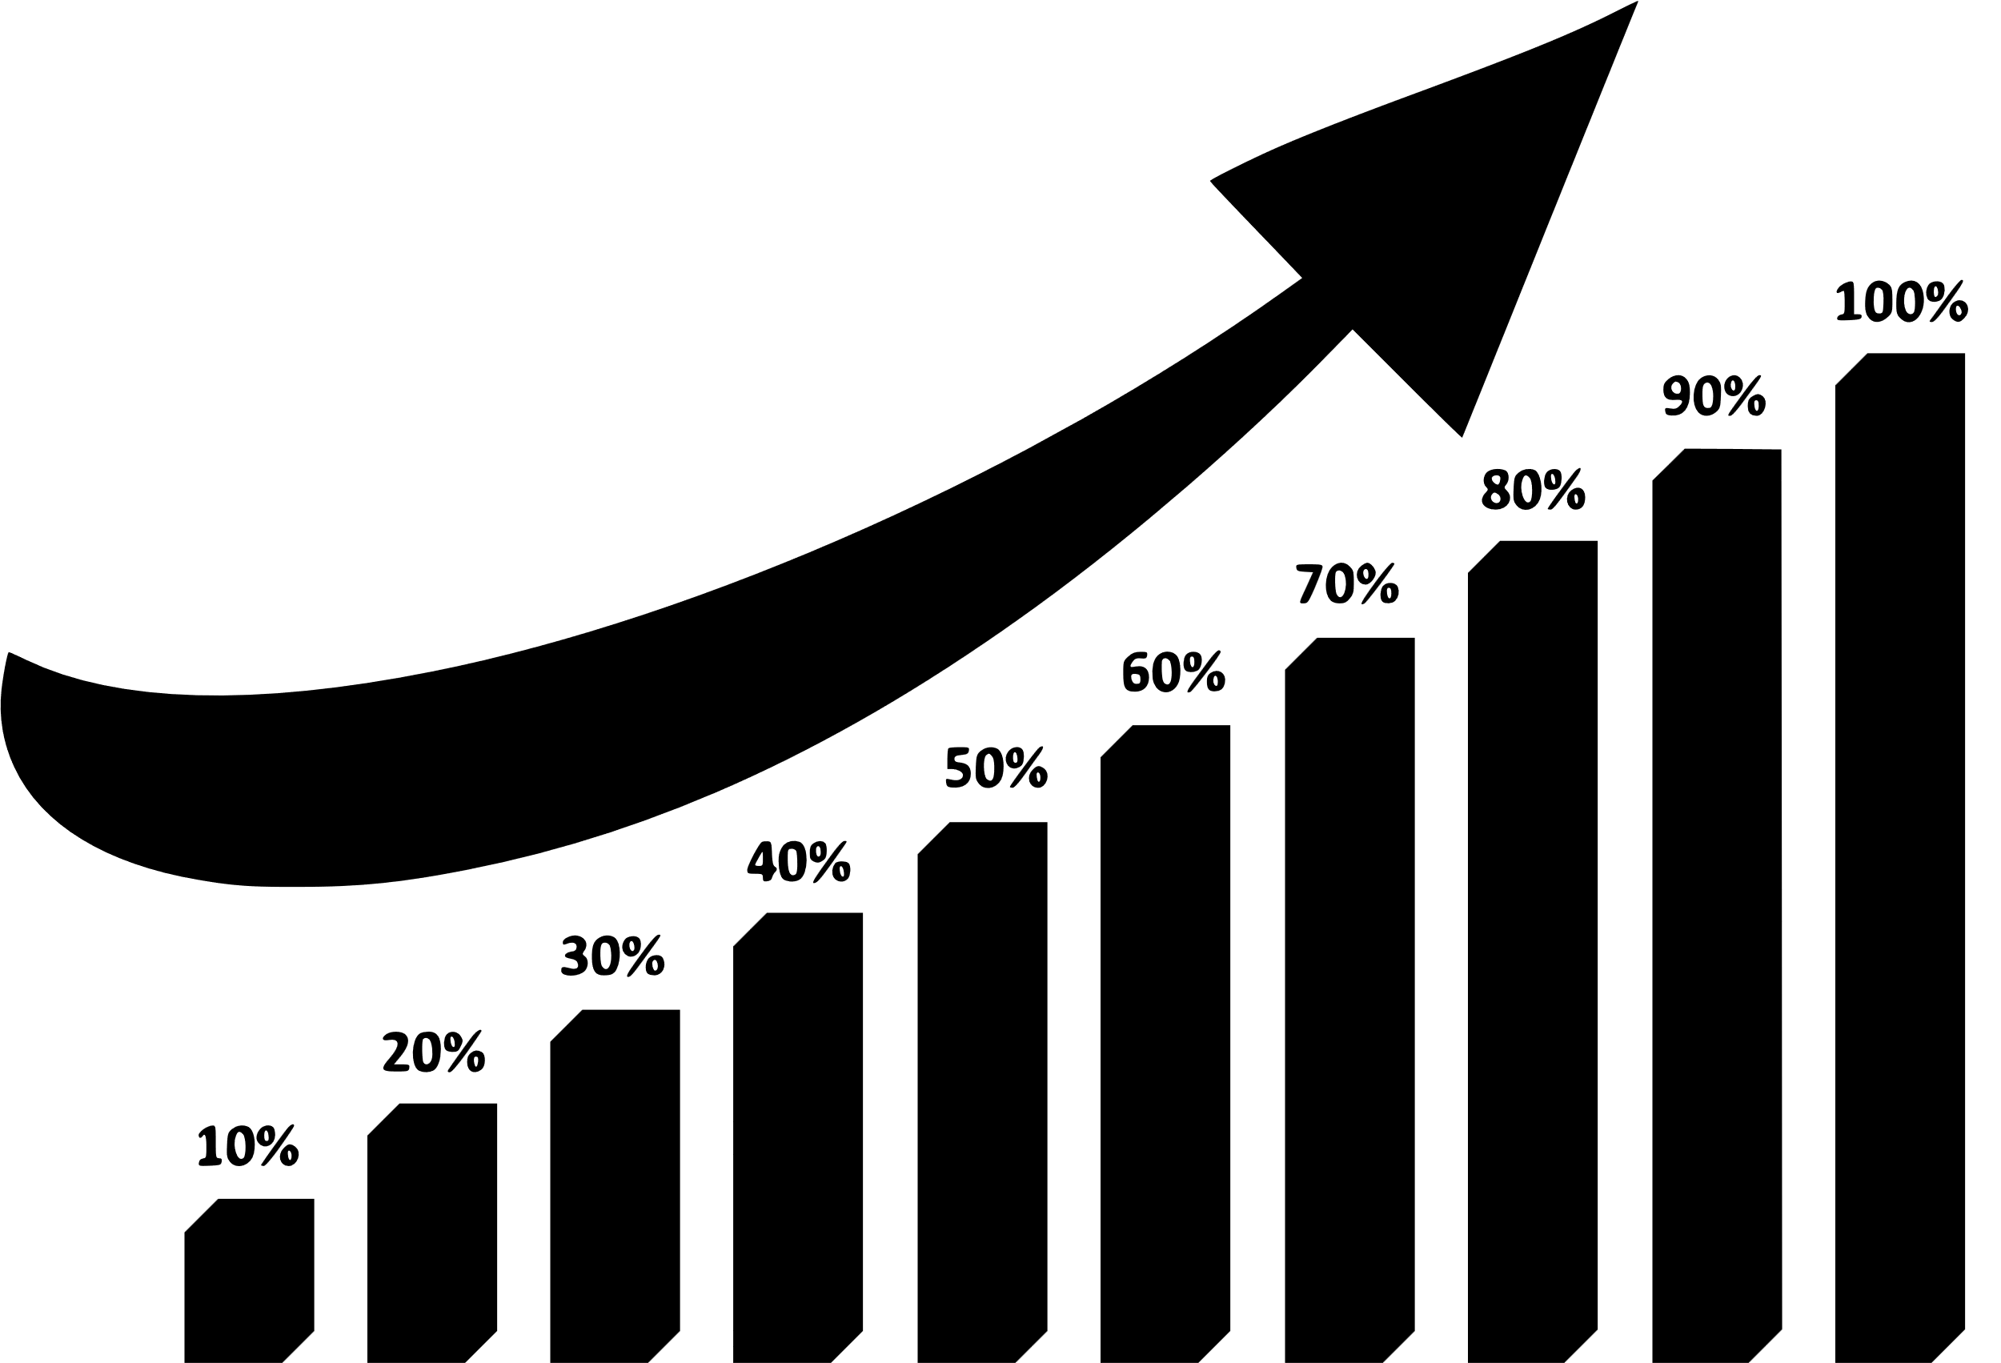
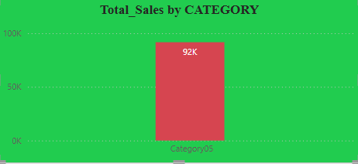
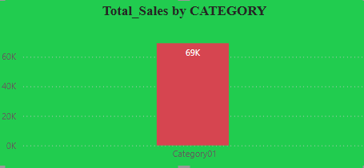
Sales by Category
TOP SALES BY CATEGORY
LAST SALES BY CATEGORY

Slide 6

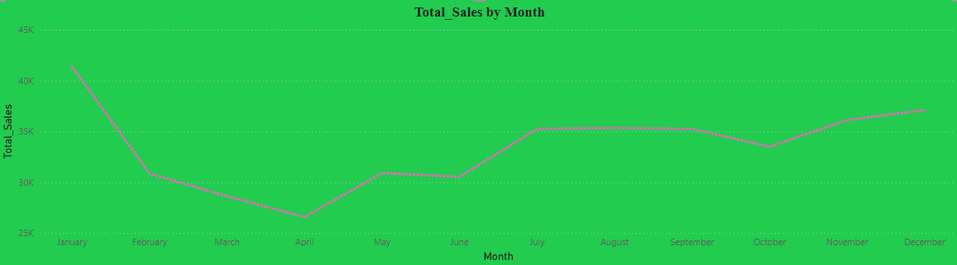
Sales Trend Over Time
Sales peaked IN DECEMBER & JANUARY due to seasonal demand

Slide 7

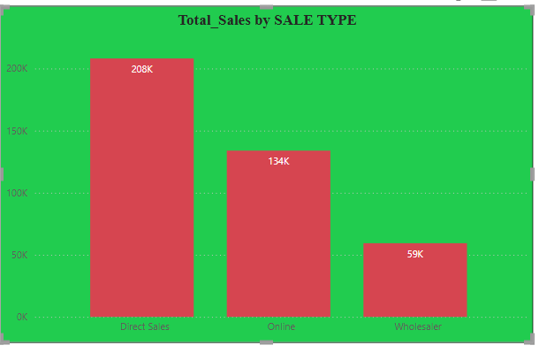
SALES BY SALE TYPE
The majority of our revenue comes from Direct Sales, indicating stronger performance in customer-facing channels compared to Wholesale.

Slide 8


